Slide 1


Chapter Seven
Wages and Employment in a Single Labour Market
Prepared by Dr. Mir Ahasan Kabir
York University

Slide 2
Learning Objectives
Starting with individuals’ labour supply decisions and firms’ labor demand choices, construct market supply and demand curves and compute the equilibrium wage and employment levels.
Contrast the equilibrium level of wage and employment under perfect competition to the case where there is imperfect competition in the market for goods, in the presence of a monopoly, an oligopoly, or monopolistic competition.
Explain why, compared to the case of perfect competition, employment and wages are lower when the firm is a monopsony in the labour market.
Describe how the minimum wage has a negative effect on employment under perfect competition, but that the effect can turn positive when a firm is a monopsony.
Discuss how estimating the effect of the minimum wage on employment has been the source of some controversy.
© 2021 MCGRAW-HILL EDUCATION LTD.
7 - <number>

Slide 3
Main Questions
How is the equilibrium wage and employment level determined in a single labour market?
How does imperfect competition affect the way in which we use the supply and demand model to analyze wages and employment determination?
Are payroll taxes “job killers”? Does the impact of these taxes fall on workers or firms?
What is monopsony? How do wage and employment outcomes differ in labour markets where firms have market power in the hiring of labour? How much worse off might workers be if they have few alternative places of employment?
Do minimum wages do more harm than good?
© 2021 MCGRAW-HILL EDUCATION LTD.
7 - <number>

Slide 4
A Guide to Chapter 7
Imperfect competition in the product market, and its impact on the labour demand function.
The competitive supply and demand model; solving for and interpreting the equilibrium, and applying the model to an evaluation of payroll taxes.
Monopsony in the labour market, or employment determination when firms (but not workers) can affect the wage.
Measuring the impact of the minimum wage on employment.
© 2021 MCGRAW-HILL EDUCATION LTD.
7 - <number>

Slide 5
The Competitive Firm’s Interaction with the Market
Competitive in both the product and the labour markets
Assumptions:
  Homogeneous type of labour
  Price taker and wage taker
  Supply of labour is perfectly elastic (horizontal) at the wage rate
  Firms can employ all the labour they need at the market wage rate
  Market wage rate is set by the aggregate labour market
© 2021 MCGRAW-HILL EDUCATION LTD.
7 - <number>

Slide 6
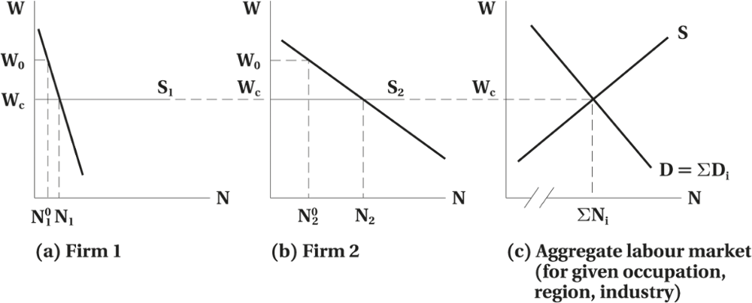
The Competitive Firm’s Interaction with the Market
Figure 7.1 Competitive Product and Labour Markets
© 2021 MCGRAW-HILL EDUCATION LTD.
7 - <number>

Slide 7
The Competitive Firm’s Interaction with the Market
Short-Run vs. Long-Run
In the short run a firm (firms) may raise its (their) demand for additional workers as demand for its (their) product increases.
Given the upward sloping labour supply curve, the wage rate as well as employment will increase in short run.
Short-run wage increases can be a market signal, resulting in increase in the labour force in long run (labour supply curve shifts to the right).
© 2021 MCGRAW-HILL EDUCATION LTD.
7 - <number>

Slide 8
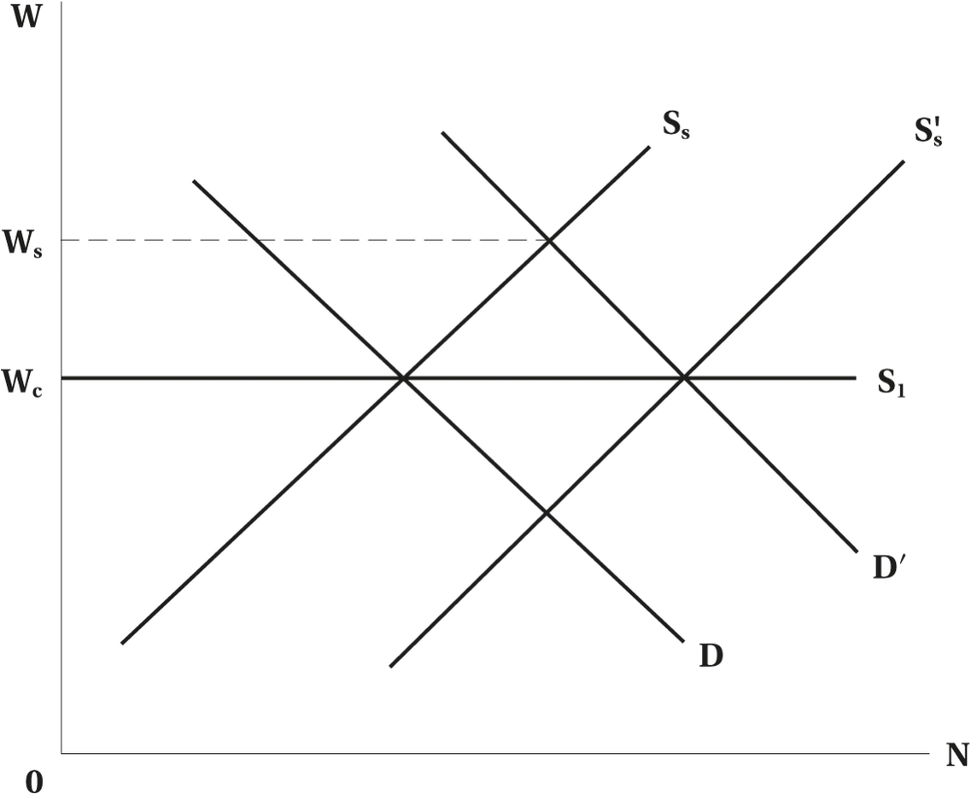
The Competitive Firm’s Interaction with the Market
Figure 7.2 Short-Run and Long-Run Labour Supply Schedules to the Firm
© 2021 MCGRAW-HILL EDUCATION LTD.
7 - <number>

Slide 9
The Competitive Firm’s Interaction with the Market
Equilibrium in a Competitive Market
Characteristics of the long run equilibrium and the market-clearing model (neoclassical)
  For markets with homogeneous workers and homogeneous jobs, wages will be equalized across workers
  In the short run, firms may have to raise wage to attract additional workers
    “Dynamic Monopsony”
© 2021 MCGRAW-HILL EDUCATION LTD.
7 - <number>

Slide 10
Imperfect Competition in the Product Market
Monopoly
Effects of hiring more labour
  Marginal physical product (MPPN) of labour falls
  Marginal revenue (MRQ) falls
  Sells more output only by lowering the product price
© 2021 MCGRAW-HILL EDUCATION LTD.
7 - <number>

Slide 11
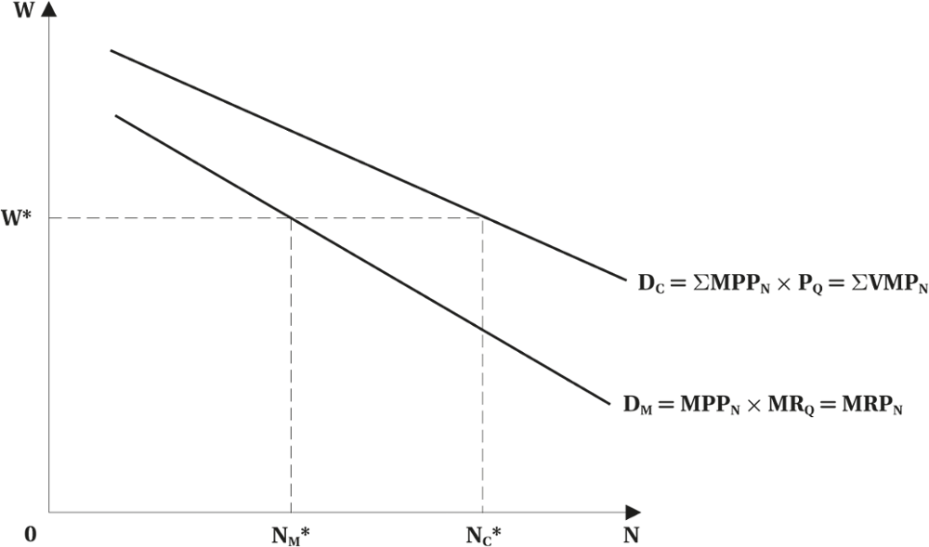
Imperfect Competition in the Product Market
Figure 7.3 Monopolist versus Competitive Demand for Labour
© 2021 MCGRAW-HILL EDUCATION LTD.
7 - <number>

Slide 12
Imperfect Competition in the Product Market
Oligopoly
Few firms
Similar products
Action of one firm affects the others
May depart from market wages because:
  Firms earn above normal profits, some of which may be captured by workers since larger firms may pay above-market wages
© 2021 MCGRAW-HILL EDUCATION LTD.
7 - <number>

Slide 13
Imperfect Competition in the Product Market
Monopolistic Competition
Many small firms with differentiated products giving the firm some discretion in price setting
Short-Run
  Earn Economic Profit
    Able to pay higher than the market wage
Long-Run
  No Economic Profit
    Must pay the market wage
© 2021 MCGRAW-HILL EDUCATION LTD.
7 - <number>

Slide 14
Imperfect Competition in the Product Market
Product Market Structure and Departure from Market Wages
Monopolist:
  Earns higher profits and labour may be able to appropriate some of these profits
  May be less cost conscious and may yield to wage demands
  Sensitive to public image pay higher wages to buy good image
  Large firms pay higher wages
© 2021 MCGRAW-HILL EDUCATION LTD.
7 - <number>

Slide 15
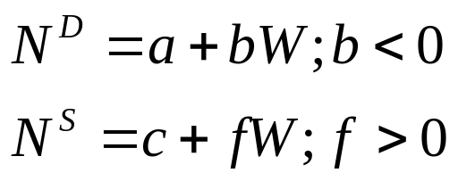
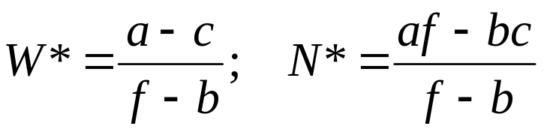
Working with Supply and Demand
Linear Supply and Demand
Setting N^{S} = N^{D}, solve for market equilibrium
© 2021 MCGRAW-HILL EDUCATION LTD.
7 - <number>

Slide 16
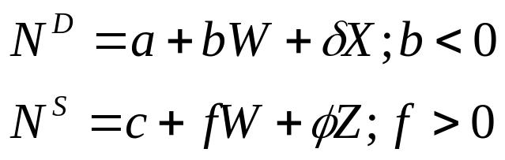
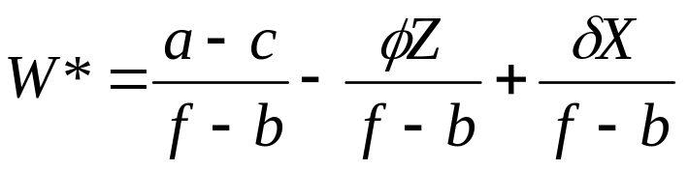
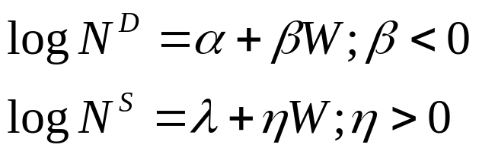
Working with Supply and Demand
Add a variable (shifter) to the model
Setting N^{S} = N^{D}, solve for market equilibrium
Log-linear
© 2021 MCGRAW-HILL EDUCATION LTD.
7 - <number>

Slide 17
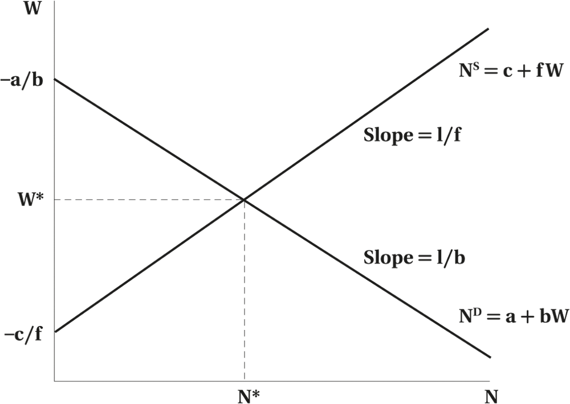
Working with Supply and Demand
Figure 7.4 Linear Supply and Demand Functions
© 2021 MCGRAW-HILL EDUCATION LTD.
7 - <number>

Slide 18
Working with Supply and Demand
Application: Incidence of a Unit Payroll Tax
Tax levied on employers
Proportional to the firm’s payroll
    CPP/QPP
    Workers’ compensation
    Unemployment insurance
    Health insurance
Often considered “job killers”
© 2021 MCGRAW-HILL EDUCATION LTD.
7 - <number>

Slide 19
Working with Supply and Demand
Table 7.1 Payroll Taxes as a Percentage of Labour Income by Type of Payroll Tax, Canada, 1971 and 1997
Type of Payroll Tax | 1971 | 1997
Workers’ compensation | 0.73 | 1.61
Unemployment insurance | 1.06 | 4.98
Canada/Quebec pension | 2.12 | 3.92
Health and/or education | 0.21 | 1.71
Total | 4.12 | 12.23
© 2021 MCGRAW-HILL EDUCATION LTD.
7 - <number>

Slide 20
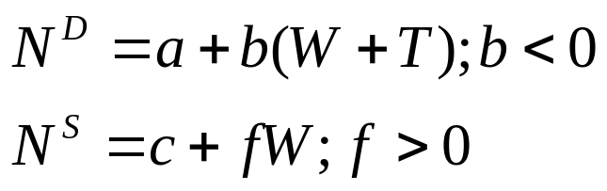
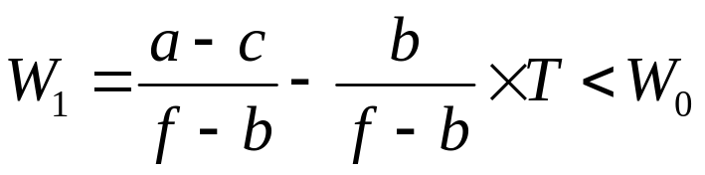
Working with Supply and Demand
Incidence of a Payroll Tax
Add a variable (shifter) to the model
Setting N^{S} = N^{D}, solve for market equilibrium
© 2021 MCGRAW-HILL EDUCATION LTD.
7 - <number>

Slide 21
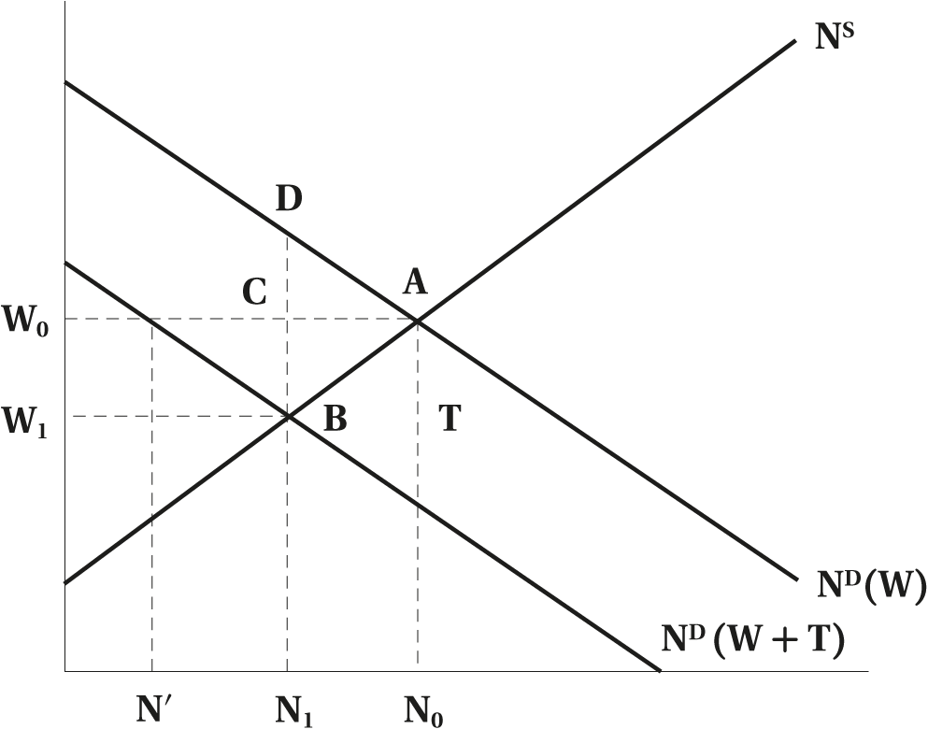
Working with Supply and Demand
Figure 7.5 The Effect of a Payroll Tax on Employment and Wages
© 2021 MCGRAW-HILL EDUCATION LTD.
7 - <number>

Slide 22
Monopsony in the Labour Market
A monopsony is a large firm relative to the size of the labour market
It influences the wage rate
It can raise wages to attract labour
Will not lose all its work force if wages are decreased
Upward-sloping labour supply schedule
© 2021 MCGRAW-HILL EDUCATION LTD.
7 - <number>

Slide 23
Monopsony in the Labour Market
Average cost is the wage rate
Marginal cost is the new wage plus the cost of paying the higher wage to existing workers
Marginal cost is higher than average cost
Profit maximization when MC = VMP
© 2021 MCGRAW-HILL EDUCATION LTD.
7 - <number>

Slide 24
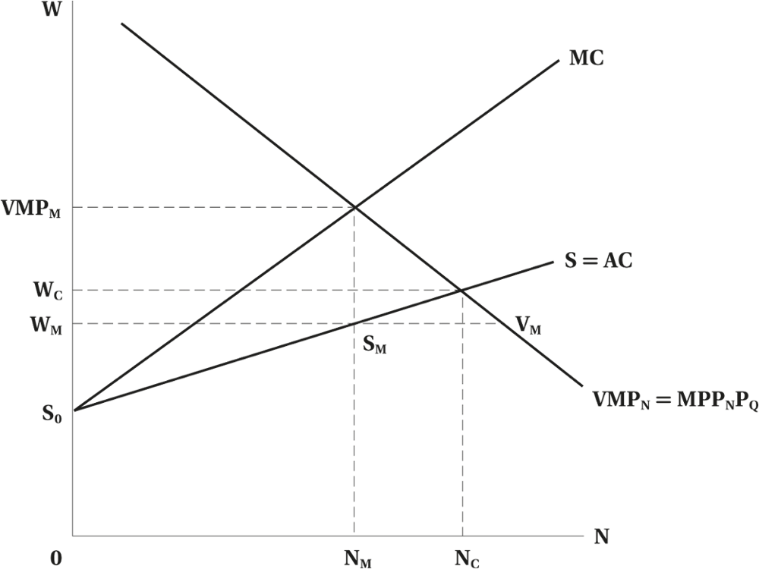
Monopsony in the Labour Market
Figure 7.6 Monopsony
© 2021 MCGRAW-HILL EDUCATION LTD.
7 - <number>

Slide 25
Monopsony in the Labour Market
Implications of a Monopsony
Employment is lower than a competitive situation
Restricts employment because hiring additional labour is costly
Higher wages must be paid to intra-marginal workers
© 2021 MCGRAW-HILL EDUCATION LTD.
7 - <number>

Slide 26
Monopsony in the Labour Market
Characteristics of Monopsonistic Market
Some inelasticity of supply of labour
Most firms have an element of monopsony power in short run
Long run costly problems of recruitment, turnover and morale issues
Examples of monopsony in long run:
  Would be a one industry town in an isolated region
  If workers have specialized skills that are useful mainly in a specific firm
© 2021 MCGRAW-HILL EDUCATION LTD.
7 - <number>

Slide 27
Monopsony in the Labour Market
Perfect Monopsonistic Wage Differentiation
Existing workers receive higher wages when a monopsony raises the wage rate
Monopsonist may try to retain some of this seller’s surplus by differentiating its work force
© 2021 MCGRAW-HILL EDUCATION LTD.
7 - <number>

Slide 28
Monopsony in the Labour Market
Perfect Monopsonistic Wage Differentiation
Supply schedule equals to the average cost and marginal cost
Does not have to pay existing workers any more than their reservation wage
Monopsonists may try to conceal higher wages or use nonwage mechanisms to attract additional labour
© 2021 MCGRAW-HILL EDUCATION LTD.
7 - <number>

Slide 29
Evidence of Monopsony
Professional Sports
Labour Markets for Teachers
Monopsony may be quite common in the short run.
Monopsony may help us understand how labour markets work better than is the traditional competitive model.
  Manning (2003)
© 2021 MCGRAW-HILL EDUCATION LTD.
7 - <number>

Slide 30
Minimum-Wage Legislation
A useful illustration of the practical relevance of our theoretical knowledge of neoclassical labour markets.
  An important area of research
  Provincial jurisdiction
© 2021 MCGRAW-HILL EDUCATION LTD.
7 - <number>

Slide 31
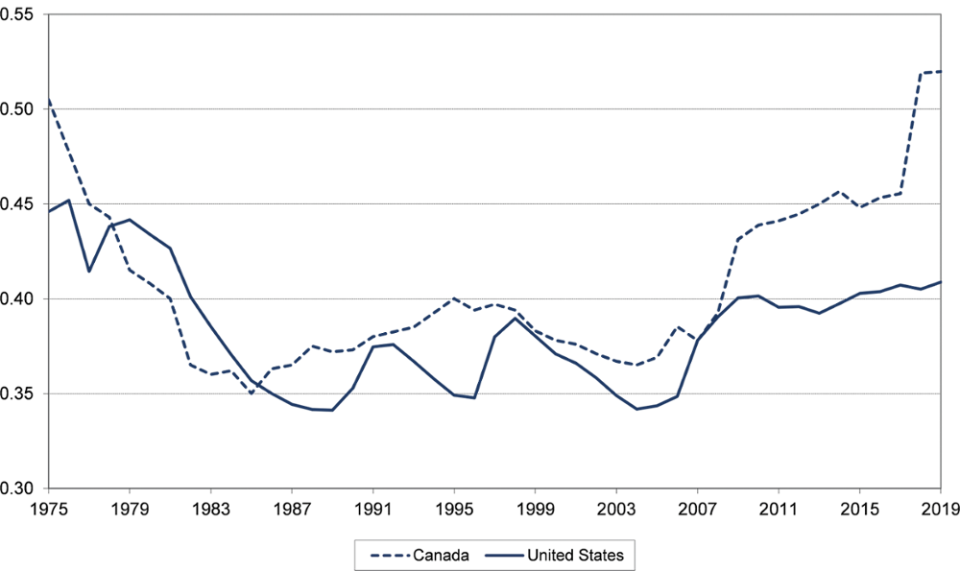
Minimum-Wage Legislation
Figure 7.7 The Ratio of Minimum Wages to Average Wages, Canada and the United States, 1975–2019
© 2021 MCGRAW-HILL EDUCATION LTD.
7 - <number>

Slide 32
Minimum-Wage Legislation
Expected Impact: Competitive Labour Market
Adverse employment effect
Firms employ less labour at a higher cost
Higher wage encourages more people to seek work
Magnitude of adverse employment effect depends on the elasticity of the demand for labour
© 2021 MCGRAW-HILL EDUCATION LTD.
7 - <number>

Slide 33
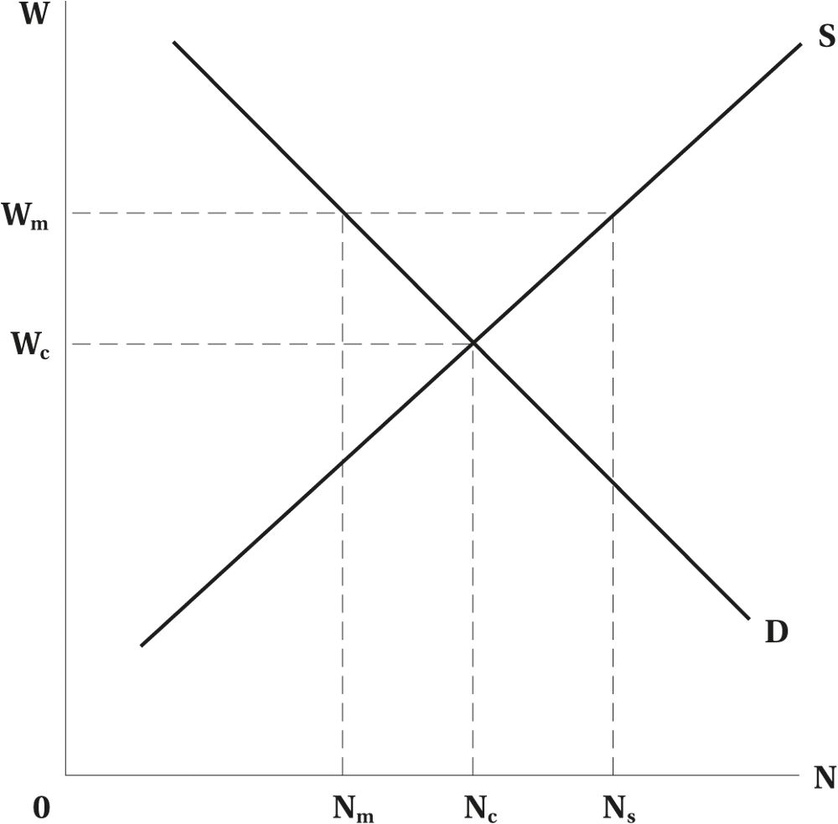
Minimum-Wage Legislation
Figure 7.8 Minimum Wage
© 2021 MCGRAW-HILL EDUCATION LTD.
7 - <number>

Slide 34
Minimum-Wage Legislation
Expected Impact: Monopsony in the Labour Market
Minimum wage (or other form of price fixing) may increase employment:
  Reduces monopsony profits
  The magnitude of these effects depend on the extent to which the monopsony is associated with workers who are paid below minimum wage
Heuristic Explanation
Practical Importance
© 2021 MCGRAW-HILL EDUCATION LTD.
7 - <number>

Slide 35
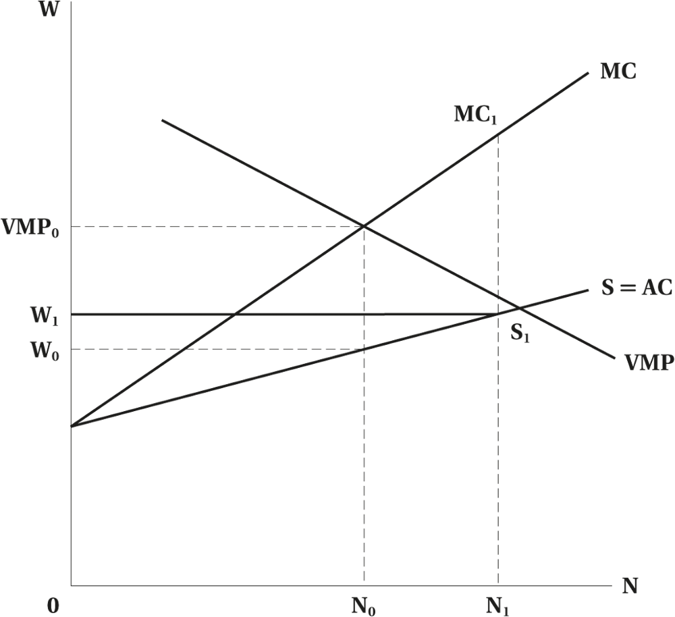
Minimum-Wage Legislation
Figure 7.9 Monopsony and a Minimum Wage
© 2021 MCGRAW-HILL EDUCATION LTD.
7 - <number>

Slide 36
Minimum-Wage Legislation
Table 7.2 Hypothetical Example of Monopsonist Responding to Minimum Wage
 | No Minimum Wage |  | Minimum Wage
Units of Labour N (1) | Wages S = AC (2) | Marg. Cost MC (3) | Wages W₁S₁S = AC (4) | Marg. Cost W₁S₁MC₁ MC (5) | Value of Marg. Prod. VMP (6)
1 | 5 | 5 | 10 | 10 | 14
2 | 6 | 7 | 10 | 10 | 13
3 | 7 | 9 | 10 | 10 | 12
4 | 8 | 11 | 10 | 10 | 11
5 | 9 | 13 | 10 | 10 | 10
6 | 10 | 15 | 10 | 10 | 9
7 | 11 | 17 | 11 | 10 | 8
© 2021 MCGRAW-HILL EDUCATION LTD.
7 - <number>

Slide 37
Minimum-Wage Legislation
Empirical Evidence on Actual Impact
There is considerable debate about the empirical impact of minimum wages on employment.
Earlier evidence suggests disemployment effect.
Recent Canadian evidence suggests that the short-run effect is small, though the disemployment effect may be higher in the long run.
© 2021 MCGRAW-HILL EDUCATION LTD.
7 - <number>

Slide 38
Chapter Summary
The determinants of employment and wage rate in a single market under perfect competition
The impact of imperfectly competitive product market on the labour market
The impact and the incidence of payroll taxes on the labour market
Monopsonistic labour market
Minimum wage and monopsonistic labour market
© 2021 MCGRAW-HILL EDUCATION LTD.
7 - <number>

